Slide 1
Impact of COVID-19 on life expectancy at birth in India: A decomposition analysis
By
Dr Suryakant Yadav¹
Co-authors: Pawan Kr Yadav¹ and Neha Yadav²
¹International Institute for Population Sciences (IIPS), Mumbai, India
²Jawaharlal Nehru University, New Delhi, India

Slide 2
Introduction
India is one of the countries experiencing excess mortality caused by COVID-19 and has more than 10.3 million confirmed cases and 1.49 lakh deceased cases of COVID-19 pandemic disease [12] in its first wave in the pandemic year 2020.
This toll of deaths is almost one-third of that in the USA and half of that in Brazil. India ranks at the third position globally in terms of the toll of deaths attributable to COVID-19 disease in 2020.
The case fatality rate (CFR) of COVID-19 deaths is 1.4% in India versus 2.8% in Brazil and 1.8% in the USA in 2020.

Slide 3
Progress in mortality transition in India

Slide 4
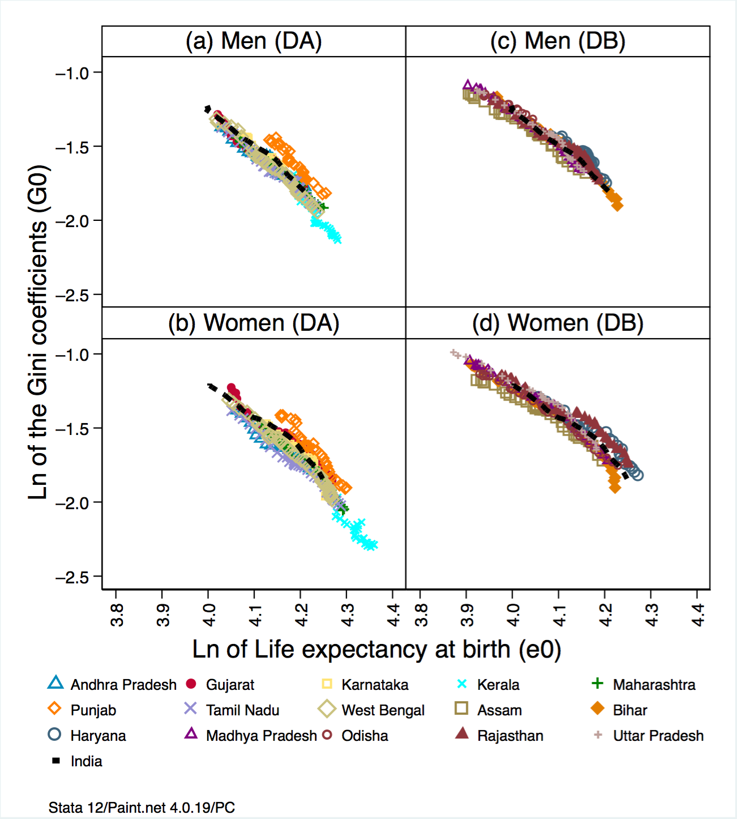
Yadav, Suryakant 2021

Slide 5
Progress in mortality transition in India
Yadav and Arokiasamy 2020

Slide 6
Yadav, Suryakant 2021

Slide 7
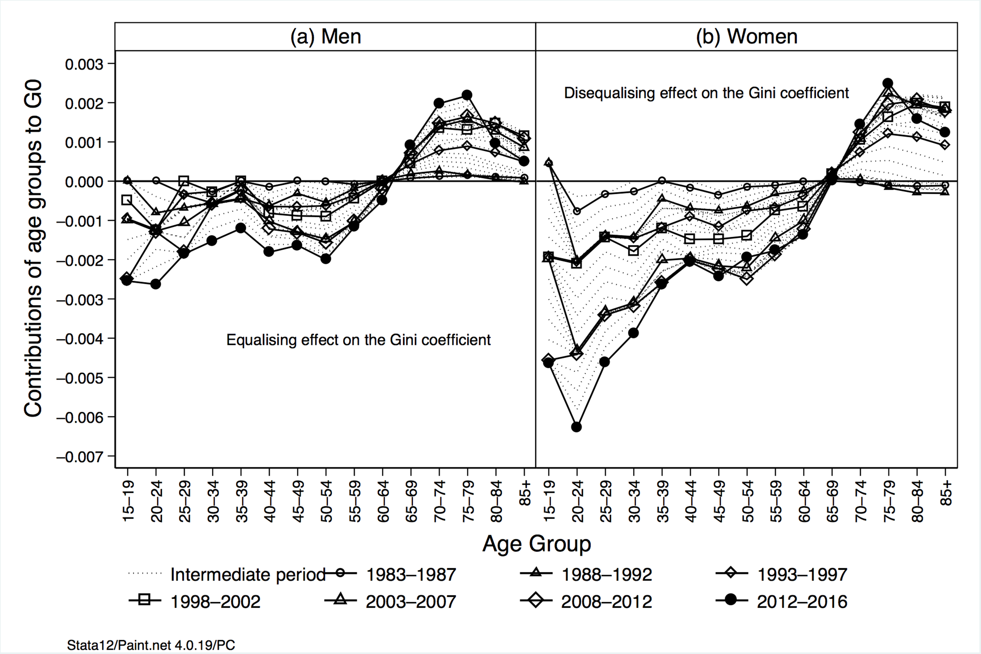
Yadav, Suryakant 2021

Slide 8
Rationale of the Study
India is one of the countries with an unparalleled convulsion caused by COVID-19 disease.
Unravelling the impact of COVID-19 disease on mortality patterns highlights mortality consequences during the first wave of the COVID-19 pandemic in India.
Many studies show that the pandemic disease has the potential to reduce e₀ by more than one year in the USA and England and Wales to 2.28 years in Madrid.

Slide 9
Rationale of the Study
A significant impact of COVID-19 disease on life table estimates also points out that with the loss in e₀, the differences in population subgroups such as sex differences (males minus females) in e₀ and G₀ might have reversed.
Distribution of COVID-19 deaths is quite different from that of overall mortality pattern. Therefore, the method of calibration is not applicable. Data constraints are apparent in the case of India.

Slide 10
Methodology
The appropriate methods would consider the COVID-19 deaths as one of many causes of death on account of excess mortality in the pandemic year 2020 and aggregates to a total number of deaths.
Construction of life tables using Chiang (1972) method.
Computation of Gini coefficient (G₀) (Hanada, 1983; Shkolnikov 2003)
$$G_{0}=1−\frac{1}{{e_{0 }\left[l_{0}\right]}^{2}}∗\sum_{t=0}^{w−1}{[ {\left(l_{t+1 }\right)}^{2}}+A_{x}^{′} \left({\left(l_{t}\right)}^{2}−{\left(l_{t+1}\right)}^{2}\right)]$$

Slide 11
Decomposition for $∆e_{0}$, ${∆G}_{0}$overtime & sex
Arriaga (1984) only for e₀
$${{}_{n}^{}Δ}_{x}^{}=\frac{l_{x}^{1} }{l_{0}}\left(\frac{{{}_{n}^{}L}_{x}^{2}}{l_{x}^{2}}−\frac{{{}_{n}^{}L}_{x}^{1}}{l_{x}^{1}}\right)+ \frac{T_{x+n}^{2}}{l_{0}}( \frac{l_{x}^{1}}{l_{x}^{2}}−\frac{l_{x+n}^{1}}{l_{x+n}^{2}})$$
Shkolnikov (2003) method for e₀ and G₀
$G_{0}−G_{0}^{′}=\sum_{i=0}^{n−1}{\left(∈_{0,x_{i+1}}− ∈_{0,x_{i}}\right)= \sum_{i=0}^{n}{∈_{i}}}$
$∈_{i}=G_{0}[M^{(x_{i})}]−G_{0}^{′}{[M}^{(x_{i})}$]

Slide 12
Seroepidemiolgical Surveys
Prevalence by Assay
Prevalence by age groups
Assay | 11 May 2020 to 04 Jun 2020 | 18 Aug 2020 to 20 Sep 2020 | 17 Dec 2020 to 08 Jan 2021
ELISA assay | 0.73 % (18+)
Abbott assay (Anti-N) |  | 6.6 % (10+) | 14.3 % (10+)
Siemens assay (Anti-S) |  |  | 24.1 % (10+)
Age group | 11 May 2020 to 04 Jun 2020 | 18 Aug 2020 to 20 Sep 2020 | 17 Dec 2020 to 08 Jan 2021
 |  |  | Anti-N | Anti-S
10-17 |  | 5.4 | 8 | 27.2
18-44 | 0.50 | 6.9 | 57 | 22.2
45-60 | 0.65 | 6.5 | 24.3 | 26.7
60+ | 0.55 | 6.2 | 10.6 | 26.3
Murhekar et al., 2020, 2021

Slide 13
Deaths and cases of COVID-19 disease in India
Deaths
Cases

Slide 14
Age pattern of mortality, COVID-19 disease, India

Slide 15
Age pattern of mortality, India, 2010-2020

Slide 16
Age pattern of mortality, India, 2010-2020

Slide 17
Trends in e₀ and G₀, India, 2010-2020

Slide 18
Comparison of life expectancy at birth

Slide 19
Age-specific contributions to e₀ by methods
Men
Women

Slide 20
Age-specific contributions to e₀, 2019-2020

Slide 21
Age-specific contributions to G₀, 2019-2020

Slide 22
Age-specific contributions to sex difference in e₀

Slide 23
Age-specific contributions to sex difference in G₀

Slide 24
Contributions to sex differences by Causes of death

Slide 25
Contributions to sex differences by NCDs

Slide 26
Contributions to sex differences by CDs

Slide 27
Contributions to sex differences by Injuries

Slide 28
Conclusion
The study demonstrates the impact of the excess mortality of COVID-19 disease on e₀ and G₀ in India.
The e₀ for M and W decline from 69.5 and 72.0 in 2019 to 67.5 and 69.8 years, in 2020 ~ approximately a loss of 2 years.
The G₀ for M and W increased from 0.15 and 0.14 in 2019 to 0.159 and 0.153, in 2020.
The age group of 35-79 years marks excess deaths caused by COVID-19 disease in 2020 compared to normal years and contributed remarkably to the sex differences in e₀ and G₀.
The COVID-19 cancel the gains of 6-8 years in e₀ and 5 years in G₀.

